Slide 1
CSE315:Introduction to Data Science
WEEK-3

Slide 2
Statistics Introduction
Statistics is the study of the collection, organization, analysis, interpretation, and presentation of data. No statistics are possible without data.

Slide 3
Types of Statistics
Descriptive Statistics: The data is described by descriptive statistics.
Inferential Statistics: Inferential statistics help in decision making by examining (Test of hypothesis) the project.

Slide 4
Types of Data used in statistics
The data used in statistics can be of two types
Primary Data - When a statistician collects data by himself or through his own team it is called primary data.
Secondary Data - Secondary data are data collected from any other source. Secondary data is not collected by the statistician himself, but from any other statistic or source. Secondary data source is always to be mentioned.

Slide 5
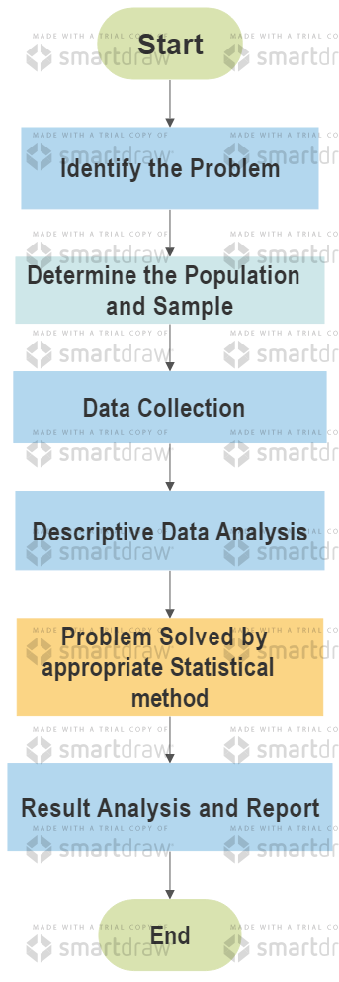
Statistical Method

Slide 6
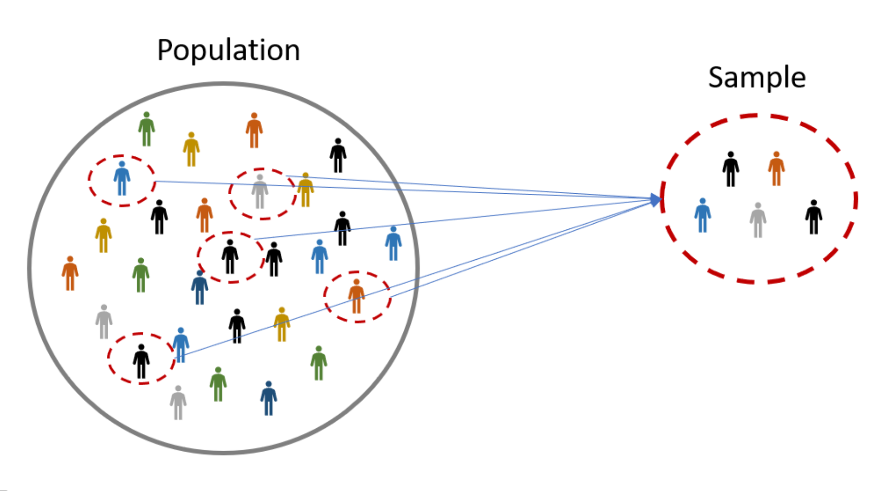
Population and Sample

Slide 7
Sample from Population
The sample must be representative, that is, the sample must represent the whole population.
Example: If an ordinary person is asked to pick a mango from a basket, he will only choose a big, fresh and ripe one. As a result, the collected specimens became one-sided, meaning that not all of these specimen represent different types of mango. So the sample has to be selected in such a way that there is no chance of bias.
If we do not select the correct sample then the results of the study will be wrong, so sampling is considered important in any study.

Slide 8
Necessity of Sampling
Suppose you want to know the average salary of all the IT professionals in Bangladesh, that is, all the IT professionals in Bangladesh are the population.
In that case you have to go to all the IT professionals in Bangladesh and find out their salary and the average that will be obtained from the data obtained will be the actual average.
When the data of all the members of the population is taken it is called census survey.
In fact, in most cases it is not possible to collect data from all members of the population. Because it requires a lot of time, manpower and money. That is why a small part representing the population is taken instead of the whole population.

Slide 9
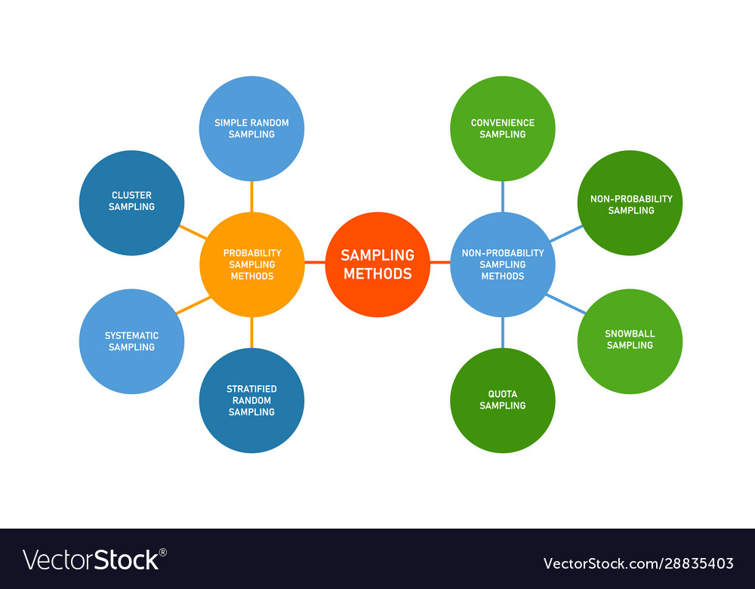
Types of Sampling

Slide 10
Probability and Non-probability Sampling
Probability Sampling - Probability Sampling has the probability of being selected as a sample of each member of the population.
Non-Probability Sampling - This method is called non-probability sampling because the researcher's judgment is important in selecting samples in non-probability sampling. Non-probability sampling usually does not use probability mechanism. The decision of the researcher is the rule in this case.

Slide 11
Types of Probability Sampling
Simple Random Sampling
Cluster Sampling

Slide 12

Simple Random Sampling
Simple Random Sampling - The most fundamental method of probability sampling is simple random sampling. In this method a certain number of samples are selected from the population through probability mechanism.
For example lottery ticket. Each ticket in the basket is likely to be selected at the time of ticket selection. Simple random sampling can also be done through random number generation.

Slide 13
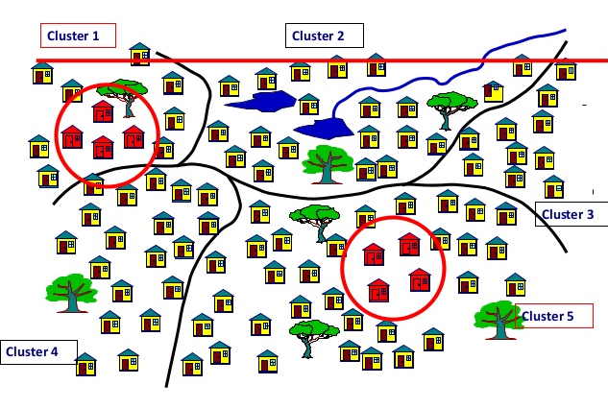
Cluster Sampling
Cluster sampling- Cluster sampling is called geographical location based sampling. For example, if a district-upazila union based sample is taken in Bangladesh, it will be a cluster sample.
Cluster samples can also be taken from other geographical divisions. Cluster sampling can again be divided into two parts, one stage cluster and two stage cluster.

Slide 14
One and two stage cluster sampling
When all the components inside a cluster are taken as samples it is a one stage cluster. Suppose each ward of Dhaka city is considered as a cluster, in which case samples of all the people of the ward will be taken in one stage cluster.
In the case of two stage clustering, instead of taking everyone inside a cluster as a sample, a certain number of samples are selected by following a simple random sampling method. In other words, we want to take data of 100 people from each cluster so 100 people will be selected again from each cluster through simple random sampling.

Slide 15

Stratified Sampling
Stratified Sampling - Stratified sampling is a homogenous group based sampling method. All members of the same group usually have the same characteristics, such groups are called strata.
For example, we want to find out the average age of students in a class. This is why we can create two separate groups of female students and male students, so that it is possible to take separate samples from each homogenous group and each sample represents a group whose members are all homogenous or possess the same characteristics.

Slide 16
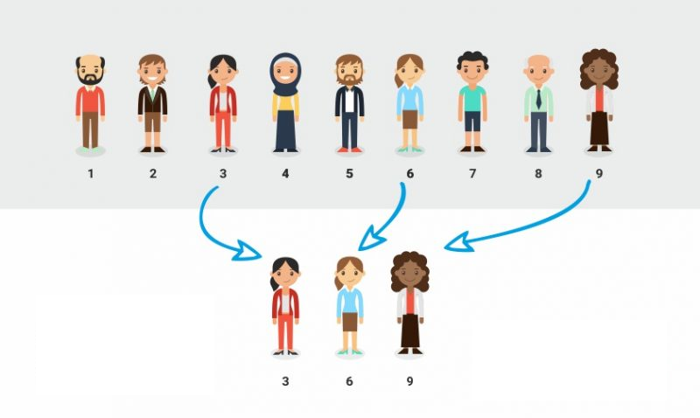
Systematic Sampling
Systematic Sampling - Systematic sampling follows a specific sequence. For example, every 2, 3, 4 or any number of data is taken. For example, if a researcher wants to study the number of family members living in a ward of Dhaka city, he wants to collect data of 100 families through systematic sampling.

Slide 17
Types of Non-probability Sampling
Judgmental Sampling
Snow-Ball Sampling
Convenience Sampling
Quota Sampling

Slide 18
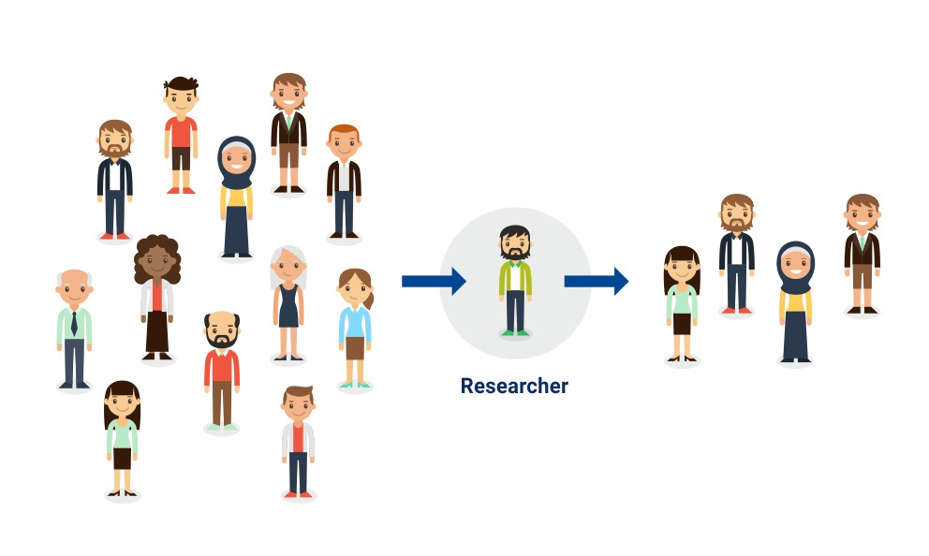
Judgmental Sampling
Judgmental Sampling - In judgmental sampling, the researcher selects samples from the population according to his own discretion.

Slide 19
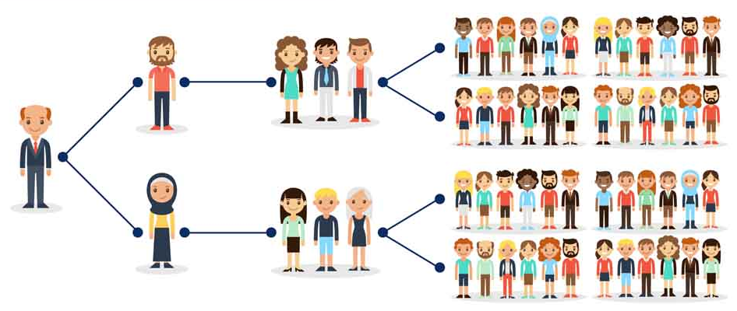
Snow-Ball Sampling
Snow-Ball Sampling - It usually takes samples that are difficult to reach in parts of the population. In this case a sample serves as a reference to the next sample.
For example, it is naturally difficult to find HIV patients or drug addicts because in most cases such people hide their identities or find them difficult to find. In such cases samples are collected by means of snow-ball sampling, in which case the reference is passed from one person to another, thus gradually reaching the entire population.

Slide 20
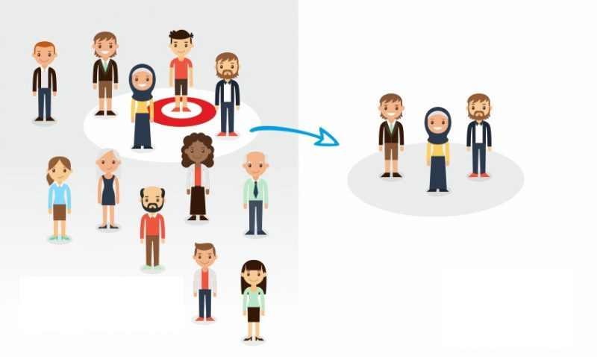
Convenience Sampling
Convenience Sampling – It allows the researcher to select a member from his or her hand or a relatively readily available sample.
For example, if a company wants to give feedback to customers about a product that is newly marketed, then feedback is taken from the buyers who are available in the market.

Slide 21
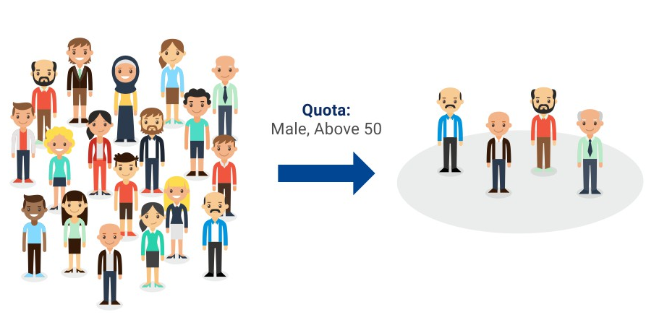
Quota Sampling
Quota Sampling - In the case of quota sampling, usually a certain proportion or quota quota is followed in the sample selection.
For example, if 80% of the population is male and 40% female, then the same ratio will be followed during sample selection.

Slide 22
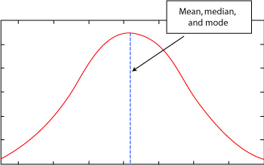
Central Tendency
Mean, mode and median is a measure of the central tendency of any data.
Many of us look at the shape of a mountain peak, sand dune or bell shape when we format any data. Most of the data is concentrated in the middle. This tendency to have data in the middle is called central tendency.

Slide 23
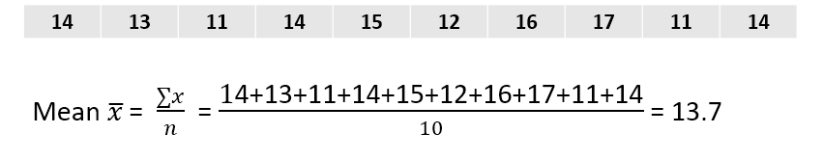
Mean
Mean - Mean is average. In simple words, the sum of all the numbers is divided by the total number of numbers.
Suppose the age of 10 students in a class is 14,13,11,14,15,12,16,17,11,14 respectively.
Data
That means we can say that the average age of students
in that class is 13.7 years.

Slide 24
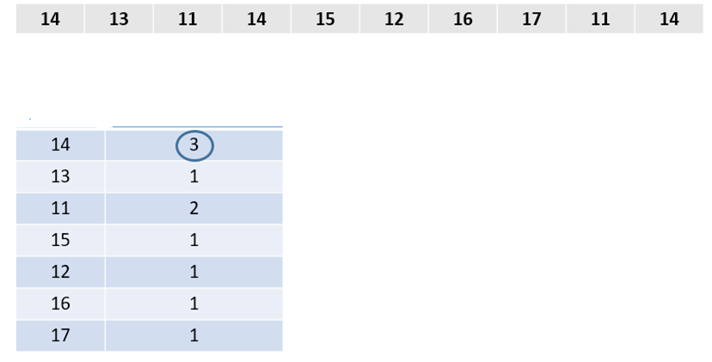
Mode
Mode- Mode is the most common number or the number that comes up the most times.
Data
Data
Frequency
Number 14 comes up most (3 times).
So, Mode=14

Slide 25


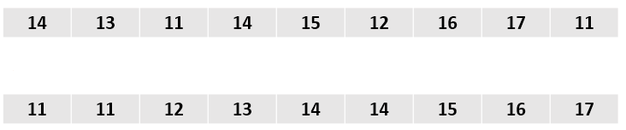
Median
Median - Median is called the middle value. Median is the middle value that is obtained by sorting the data. The median value is easily obtained if the total observation of the data is an odd number, but if the observation is an even number then the average of any two data in the middle is taken as median.
If the no. of observations are odd, then 5th data= 14
If the no. of observations are even, then
Data
Sorted Data

Slide 26
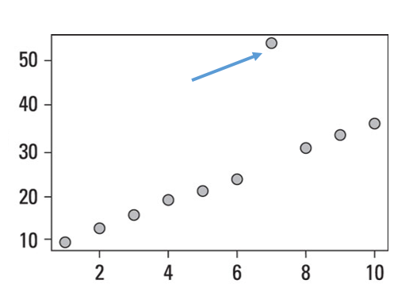
Why need median when mean has
The question that may come to your mind is why do you need median again to have mean?
The median is not affected by outlier.
Outlier - outlier is outsourced data, which means it is not like others. Whose value is much lower or much higher than most values.
Outliers may change the mean, that is, average values ​​may decrease or increase, but outliers do not affect the median value. That is why the media is needed.
Outlier

Slide 27
Data Spread
Range - Range is the sum of the maximum and minimum values ​​of the data.
For example, the maximum value is 18 and the minimum value is 11 and the difference between them is 8, this is the range. This shows how much data is stored.
Range= Maximum-Minimum= 17-11=6
Data
Sorted Data

Slide 28
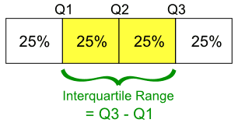
Data Spread
Quartiles and IQR - Data is divided into 4 parts by quartiles. Each section contains 25% data. It contains 50% data in the second quartiles and 25% data in the first and last quartiles.
The subtraction of 3rd quartile and 1st quartile is called inter quartile range or IQR.

Slide 29
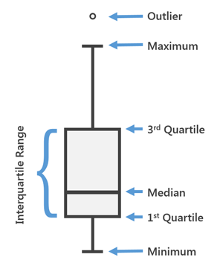
Box Plot
If a data box is plotted, maximum and minimum value of data, outlier, IQR etc. can be visualized.

Slide 30
Finding the Outliers of a Data Set
Outlier: An outlier is an observation that lies an abnormal distance from other values in a random sample from a population. In a sense, this definition leaves it up to the analyst (or a consensus process) to decide what will be considered abnormal. Before abnormal observations can be singled out, it is necessary to characterize normal observations.

Slide 31
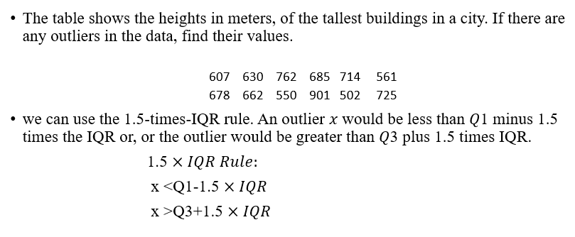
Finding the Outliers of a Data Set

Slide 32
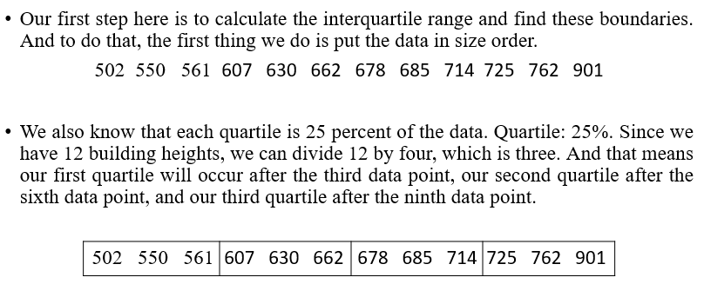
Finding the Outliers of a Data Set

Slide 33
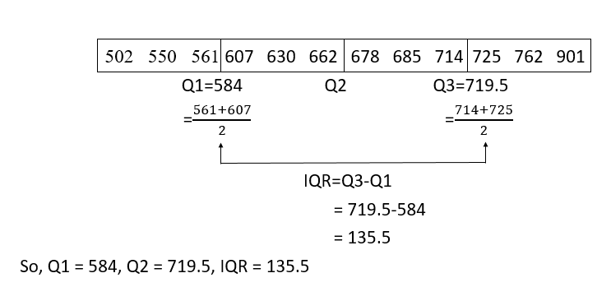
Finding the Outliers of a Data Set

Slide 34
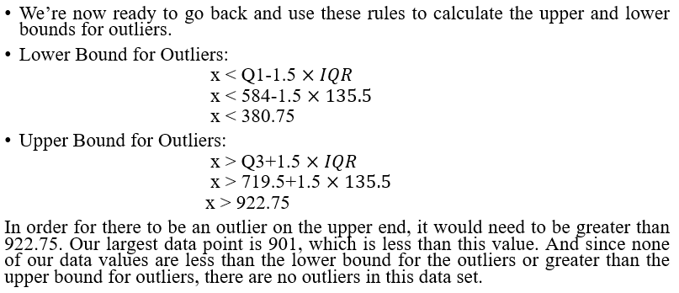
Finding the Outliers of a Data Set

Slide 35
Finding the Outliers of a Data Set
Exercise:
Find all possible outliers for the following set of data:
108, 31, 75, 87, 79, 88, 89, 118, 51, 89, 174, 95, 51, 70, and 73.
Exercise:
Your dataset has 11 values. You have a couple of extreme values in your dataset, so you’ll use the IQR method to check whether they are outliers.
26 37 24 28 35 22 31 53 41 64 29

